Slide 1
Introduction to natural language processing
AI for Business

Slide 2
What is natural language processing
Natural language processing develops methods for making human language accessible to computers.
Some well-known example applications are intelligent search engines, machine translation, and dialogue systems.
These diverse applications are based on a common set of ideas from algorithms, machine learning, and other disciplines.

Slide 3
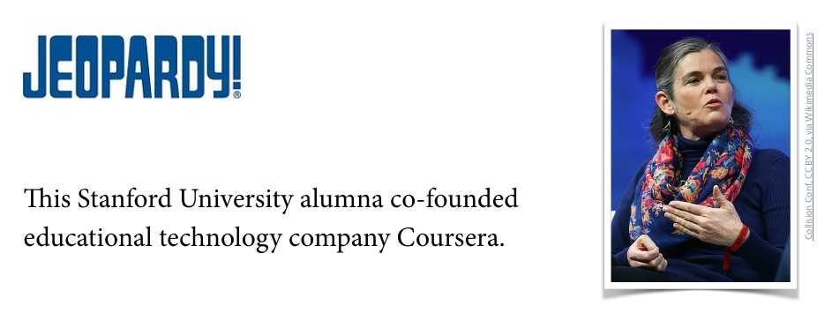
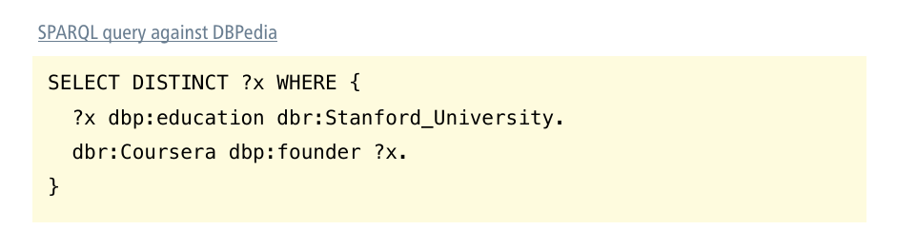

Slide 4
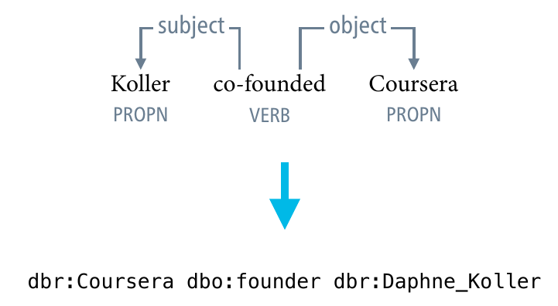
General-purpose linguistic representations

Slide 5
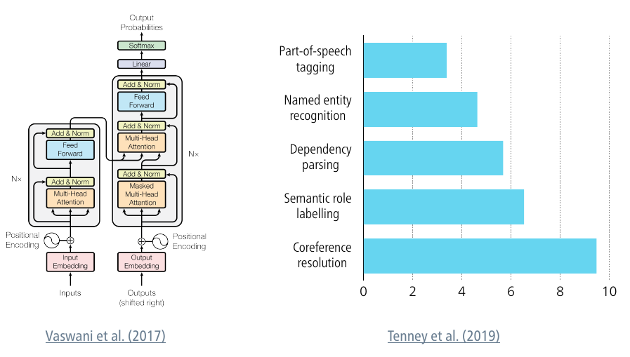
“Natural language processing from scratch”

Slide 6
Two paradigms
Linguistic knowledge
Build pipelines of modular components that produce general-purpose representations grounded in linguistic knowledge.
parts-of-speech, dependency trees, ...
Deep learning
Train end-to-end neural networks that directly transmute raw text into whatever structure the desired application requires.

Slide 7
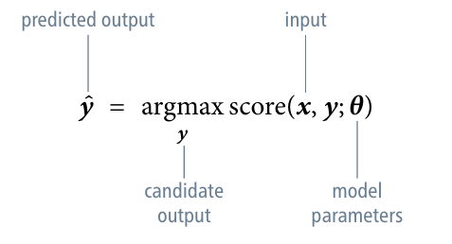
Search and learning

Slide 8
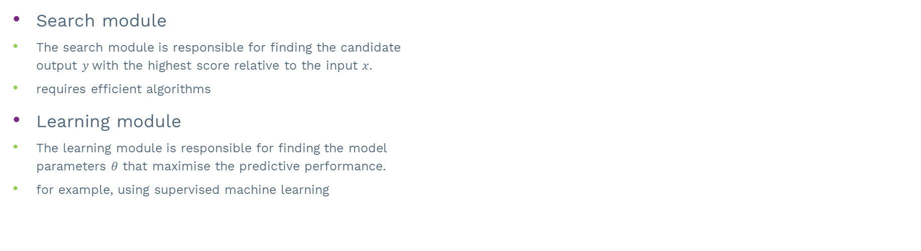
Search and learning
Search module
The search module is responsible for finding the candidate output $y$with the highest score relative to the input $x$.
requires efficient algorithms
Learning module
The learning module is responsible for finding the model parameters $θ$ that maximise the predictive performance.
for example, using supervised machine learning

Slide 9
Language is special
Unlike images or audio, text data is fundamentally discrete, with meaning created by combinatorial arrangement.
Even though text appears as a sequence, machine learning methods must account for its implicit hierarchical structure.
The distribution of linguistic elements follows a power law – algorithms must be robust to unobserved events.

Slide 10
Introduction to word representations

Slide 11
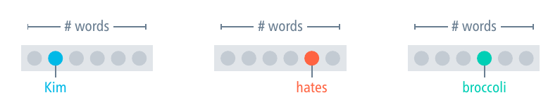
One-hot vectors
To process words using neural networks, we need to represent them as vectors of numerical values.
The classical way to do this is to use one-hot vectors – vectors in which all components but one are zero.

Slide 12
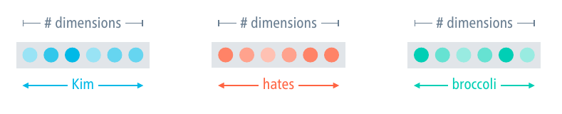
Word embeddings
Compared to one-hot vectors, word embeddings
are shorter but dense
support a useful notion of similarity
can be learned from data

Slide 13
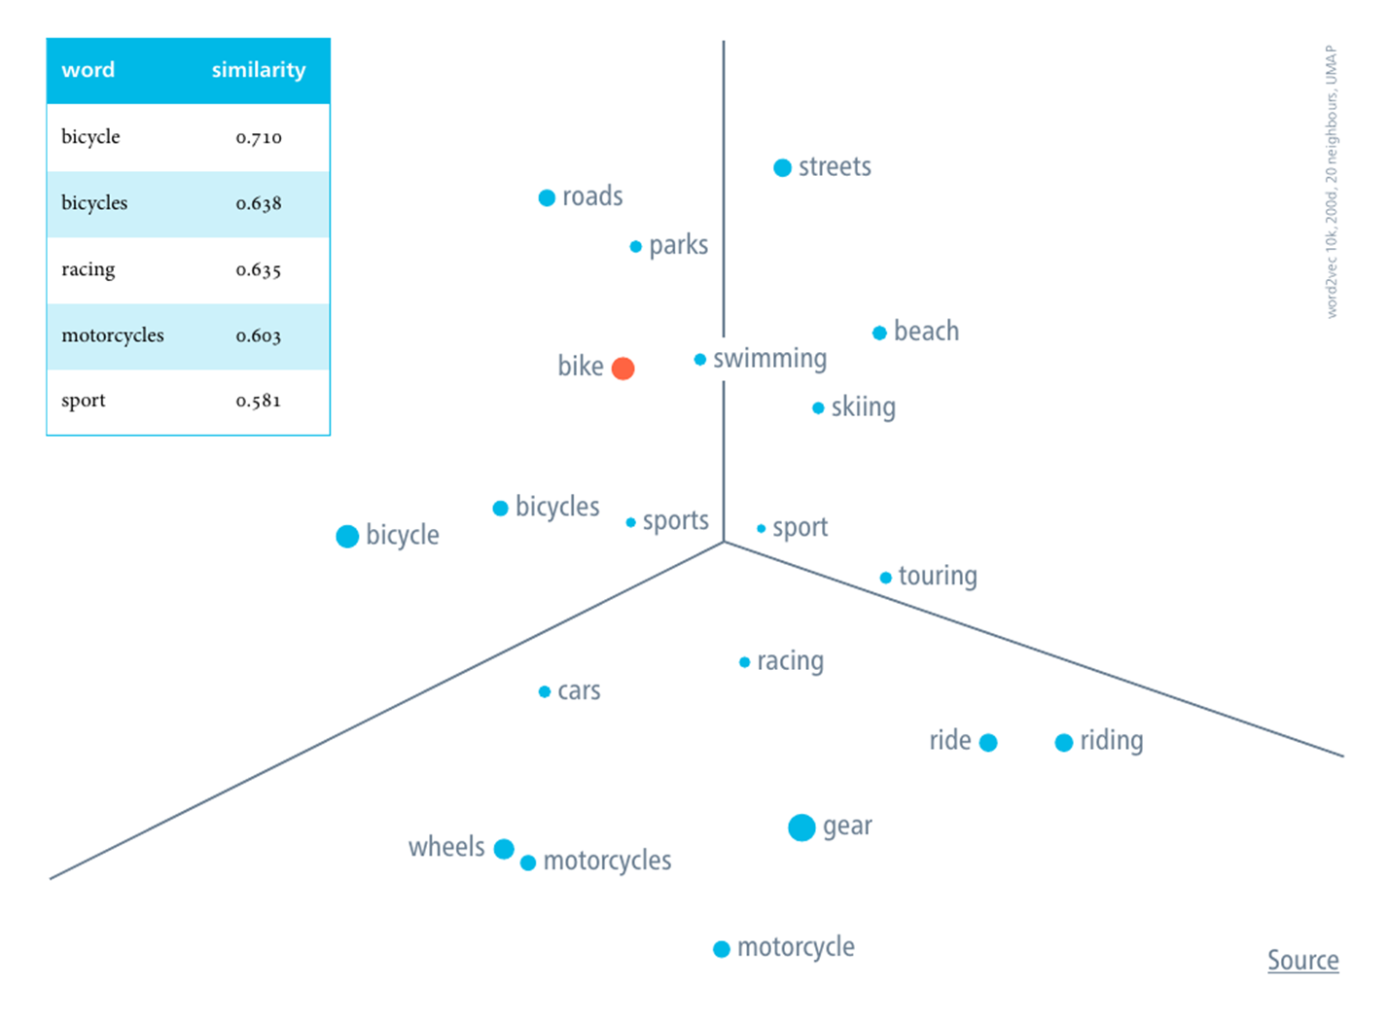

Slide 14
You shall know a word by the company it keeps
What do the following sentences tell us about Garrotxa?
Garrotxa is made from milk.
Garrotxa pairs well with crusty country bread.
Garrotxa is aged in caves to enhance mould development.
Sentences taken from the English Wikipedia

Slide 15
The distributional hypothesis
The distributional hypothesis states that words with similar distributions have similar meanings.
with similar distributions = are used and occur in the same contexts
This suggests that we can learn word representations from co-occurrence statistics.
similar co-occurrence distributions = similar meanings

Slide 16
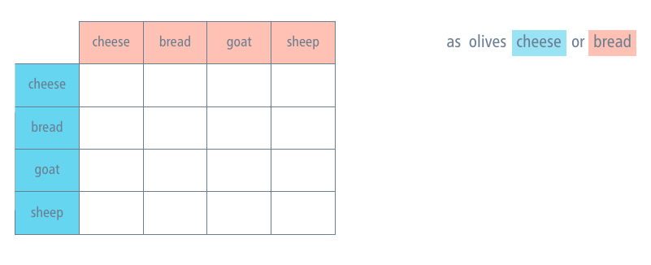
Co-occurrence matrix

Slide 17
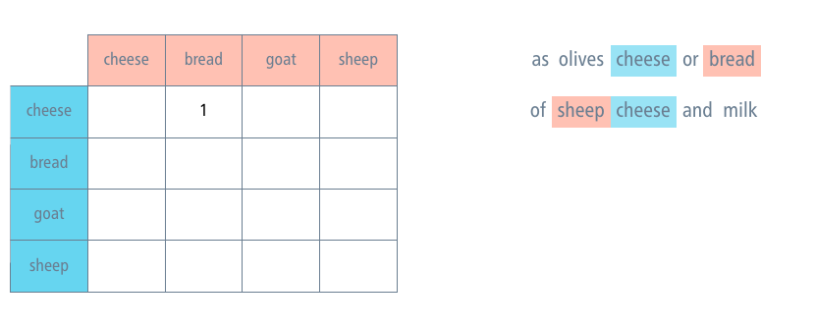
Co-occurrence matrix

Slide 18
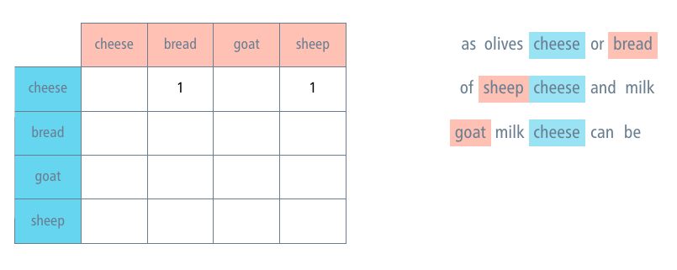
Co-occurrence matrix

Slide 19
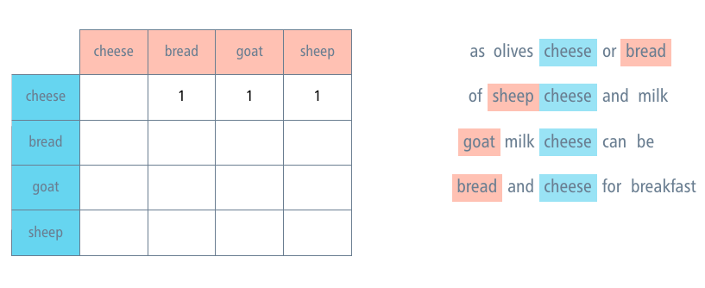
Co-occurrence matrix

Slide 20
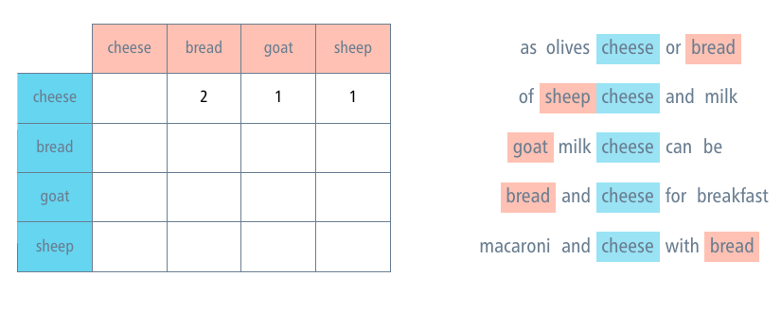
Co-occurrence matrix

Slide 21
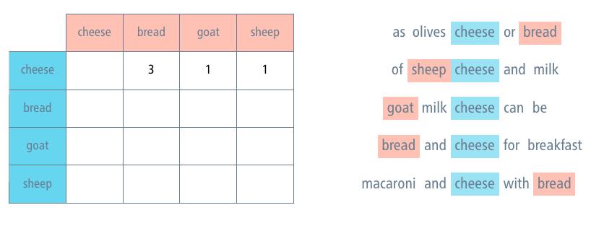
Co-occurrence matrix

Slide 22
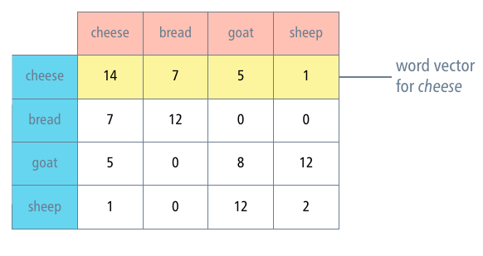
Co-occurrence matrix

Slide 23
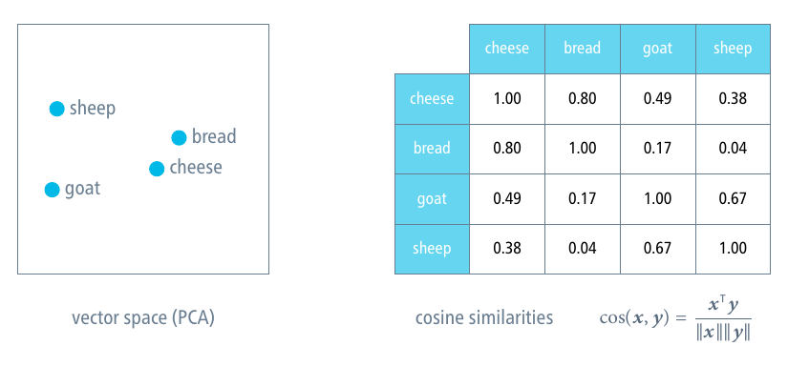
Vector similarity = meaning similarity

Slide 24
Learning word embeddings
Count-based methods: Matrix factorisation
Minimise the difference between the co-occurrence matrix and an approximate reconstruction of it from word embeddings.
Prediction-based methods: Neural networks
Maximise the likelihood of a corpus under a probability model that is conditioned on the word embeddings.

Slide 25
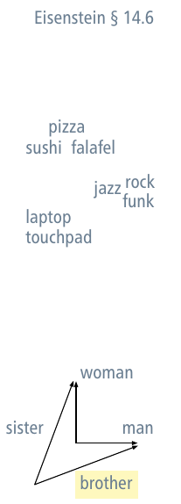
Evaluation of word embeddings
visualisation of the embedding space
Requires dimensionality reduction (PCA, t-SNE, UMAP)
computing relative similarities
cosine similarity, Euclidean distance
similarity benchmarks
Example: odd one out – breakfast lunch dinner surgery
analogy benchmarks
Example: woman is to man as sister is to ?

Slide 26
Large pre-trained language models

Slide 27
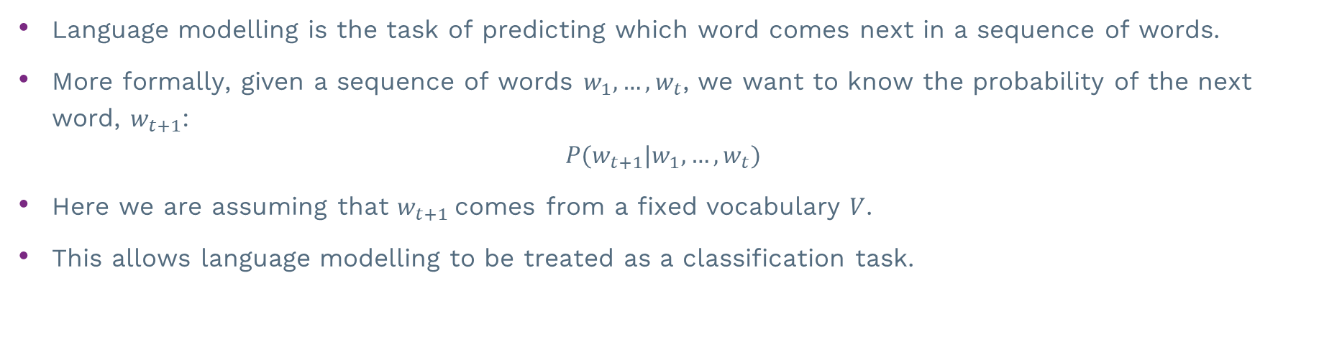
Language modelling
Language modelling is the task of predicting which word comes next in a sequence of words.
More formally, given a sequence of words $w_{1}, …, w_{t}$, we want to know the probability of the next word, $w_{t+1}$:
$$P(w_{t+1}|w_{1}, …, w_{t})$$
Here we are assuming that $w_{t+1}$comes from a fixed vocabulary $V$.
This allows language modelling to be treated as a classification task.

Slide 28
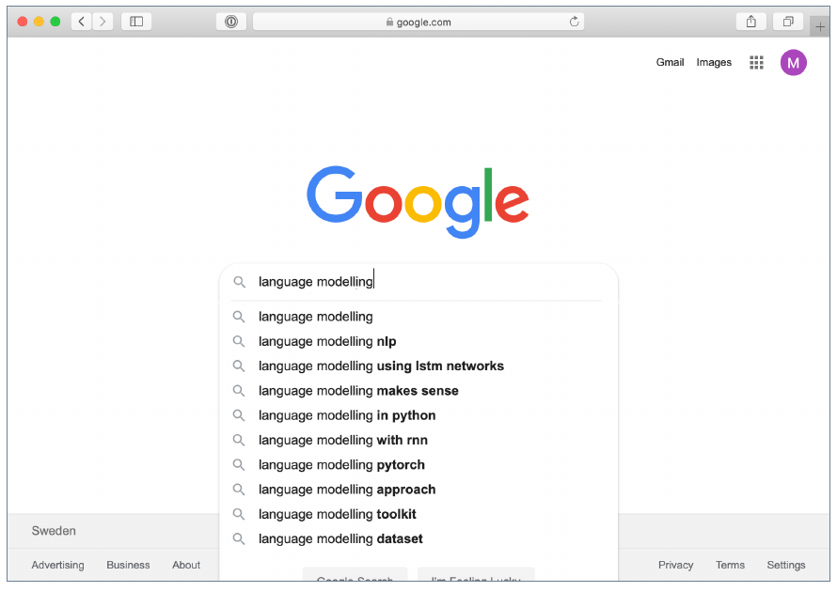

Slide 29
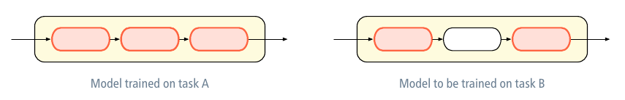
Pre-training and fine-tuning
Transfer learning aims to re-use knowledge gained while solving one problem when solving the next problem.
reduce the need for training data
In contemporary NLP, transfer learning is usually implemented through pre-training and fine-tuning.

Slide 30
Generative pre-training, discriminative fine-tuning
Idea: Combine generative pre-training (language modelling) with discriminative ne-tuning on each task.
Language modelling is a strong candidate for a pre-training task, as large unlabelled text corpora are abundant.
at least for English ...
To facilitate effective transfer learning, the authors use task-specific input transformations for fine-tuning.
Radford et al. (2018)

Slide 31
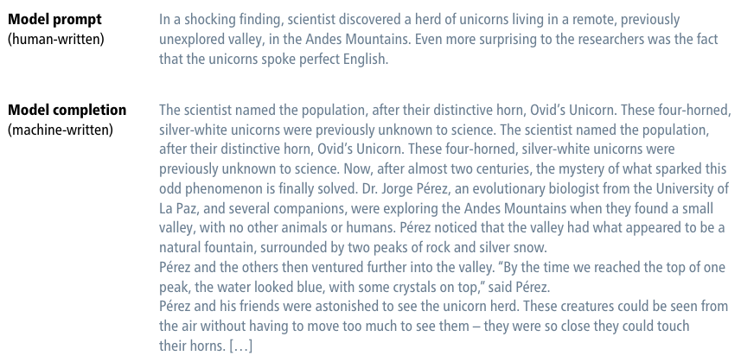
GPT as a language model
OpenAI Blog (2019

Slide 32
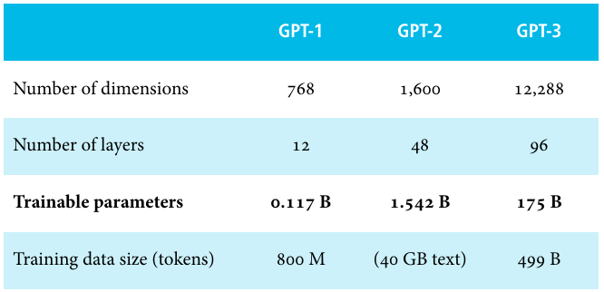
Model statistics (largest models)
Radford et al. (2018), Radford et al. (2019), Brown et al. (2020)

Slide 33
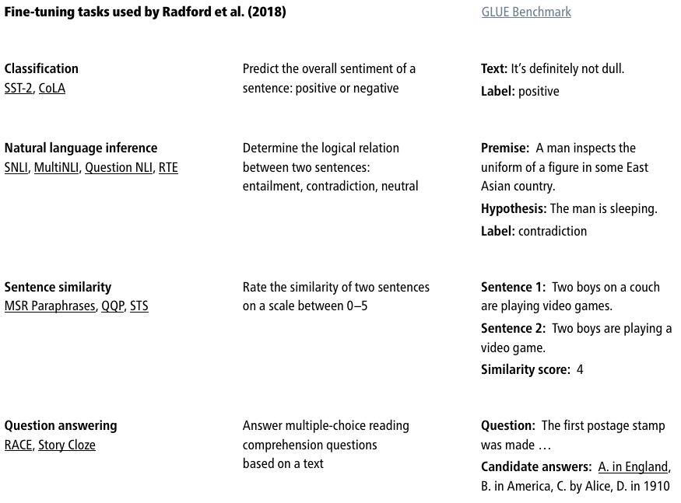

Slide 34
Fine-tuning on classification tasks
For fine-tuning on classification, the final transformer block’s output is fed into an added linear layer followed by a so max.
The transformer is frozen; the only extra parameters introduced in fine-tuning are those of the added linear layer.

Slide 35
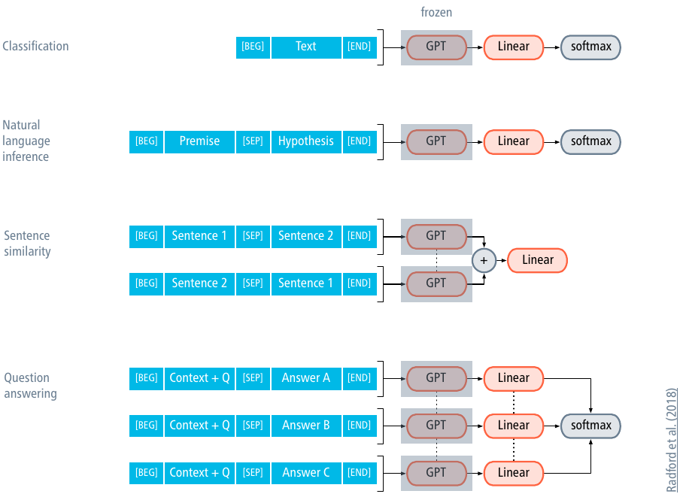

Slide 36
Large language models are zero-shot learners
Many downstream tasks are directly or indirectly ‘demonstrated’ in the text used for training language models.
translation: dictionaries, product manuals written in several languages
Language models may learn these tasks as a by-product of learning to predict the demonstrating text.
Large language models can solve downstream tasks without any task-specific fine-tuning; they are zero-shot learners.

Slide 37
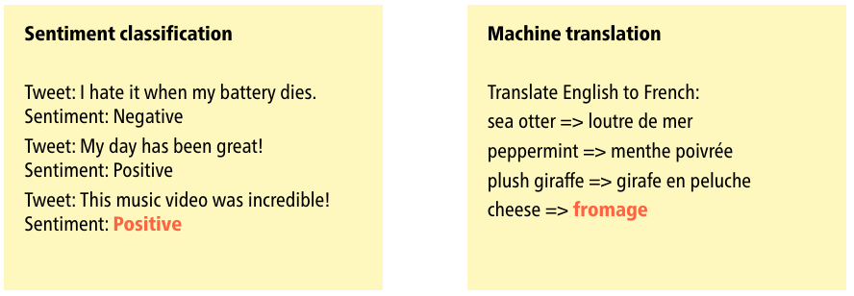
Prompting for natural language processing

